Slide 1

Session 03
Dialog Boxes
MDI Application and Menus

Slide 2
Review
Value Setting Controls
Grouping Controls
Graphic Controls
SplitContainer Control
ListView and TreeView controls
RichTextBox control
ProgressBar
Date Controls
Timer Component

Slide 3
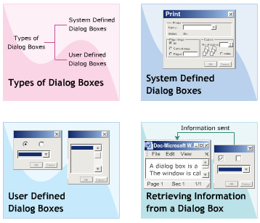
Objectives 1
Types of Dialog Boxes
System Defined Dialog Boxes
User Defined Dialog Boxes
Retrieving Information from a Dialog Box

Slide 4
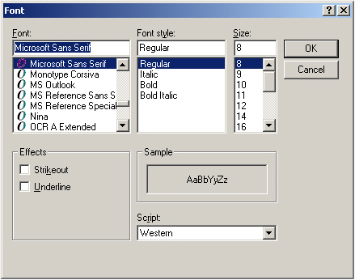
Introduction to Dialog Boxes
A dialog box is a window that allows you to collect and display related information using various controls. It allows you to group common functionalities within a single window and explore them.

Slide 5
Features
Non-resizable
Usually Modal
Contains OK and Cancel button
Types of Dialog Box
Modal dialog box
Modeless dialog box

Slide 6
Classification of Dialog Boxes
Dialog Box
Common dialog box
Custom dialog box

Slide 7
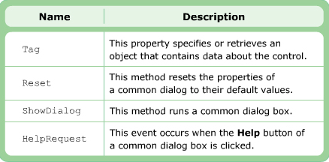
“CommonDialog” Class
The CommonDialog class is the base class for all common dialog boxes.

Slide 8
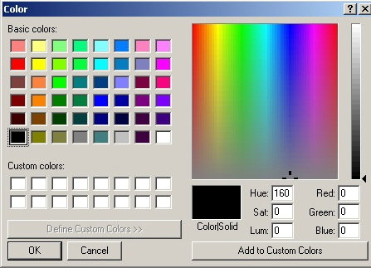
“ColorDialog” Component
The ColorDialog class allows you to create the ColorDialog component. The ColorDialog component allows you to select system-defined colors from the color palette.

Slide 9
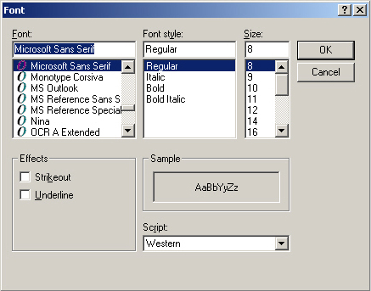
“FontDialog” Component
The FontDialog class allows you to create the FontDialog component. The FontDialog component allows you to select different fonts that are installed in the system.

Slide 10
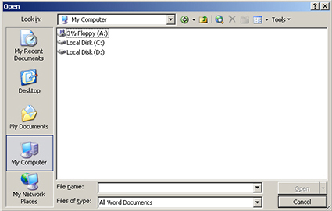
“OpenFileDialog” Component
The OpenFileDialog component allows you to open a file. The OpenFileDialog class allows you to create the OpenFileDialog component

Slide 11
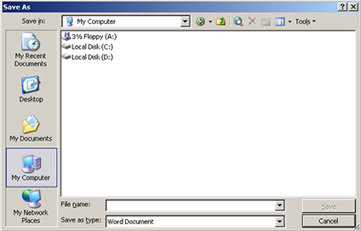
“SaveFileDialog” Component
The SaveFileDialog component allows you to open a file. The SaveFileDialog class allows you to create the SaveFileDialog component

Slide 12
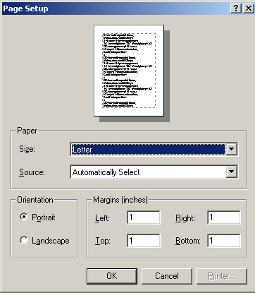
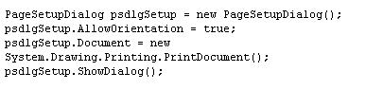
“PageSetupDialog” Component
The PageSetupDialog component is a system-defined dialog box, which allows the user to set the page layout for printing.

Slide 13
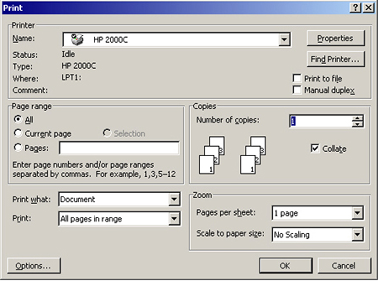
“PrintDialog” Component
The PrintDialog component is a system-defined dialog box that allows you to print the documents. It allows you to select a printer, pages to print …

Slide 14
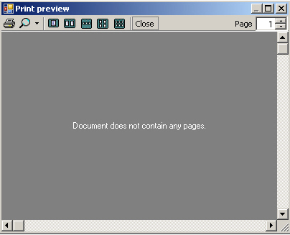
“PrintPreviewDialog” Control
The PrintPreviewDialog control is used to display the way a document will appear when printed.

Slide 15
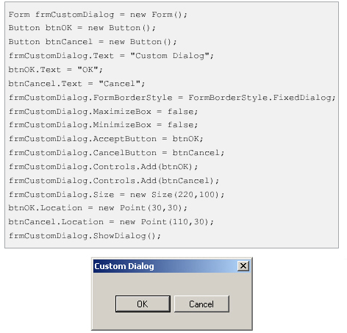
User-Defined Dialog Boxes
A system-defined dialog box does not always fulfill the requirements of the developers and users. In such as, a developer needs to create custom dialog boxes to fulfill the requirements.

Slide 16
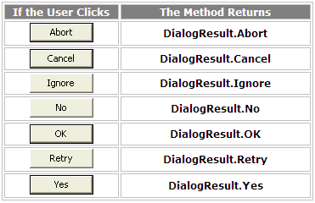
“MessageBox” class
A message box is a special dialog box used to display a piece of information to the user. The user cannot type anything in the dialog box. The .NET Framework inherently supports message boxes through its own MessageBox class
The value returned by a message box corresponds to the particular button the user would have clicked (on the message box)

Slide 17
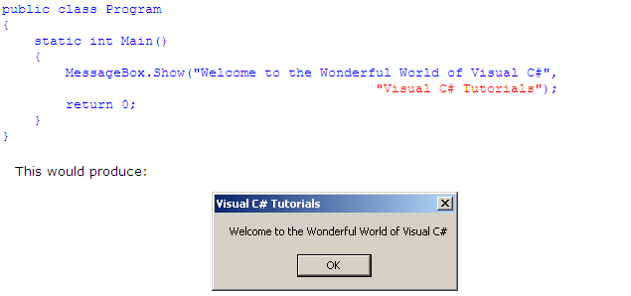
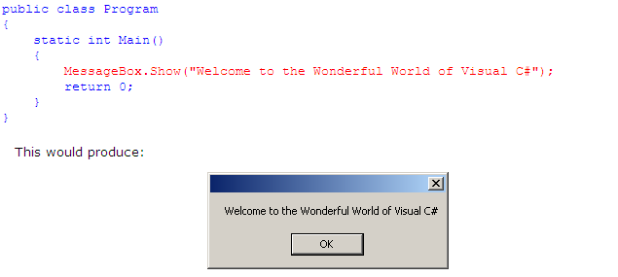
The Message of a Message Box and Caption

Slide 18
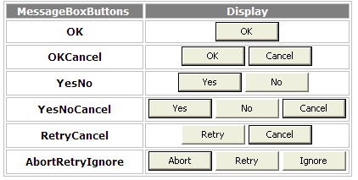
The Buttons of a Message Box
Syntax:
public static DialogResult Show(string text, string caption, MessageBoxButtons buttons);

Slide 19
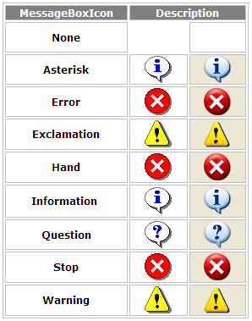
The Icon of a Message Box
Syntax:
public static DialogResult Show(string text, string caption, MessageBoxButtons buttons,MessageBoxIcon);

Slide 20
The Default Button of a Message Box
When a message box is configured to display more than one button, the operating system is set to decide which button is the default.
Syntax
public static DialogResult Show(string text, string caption, MessageBoxButtons buttons, MessageBoxIcon icon, MessageBoxDefaultButton defaultButton);

Slide 21
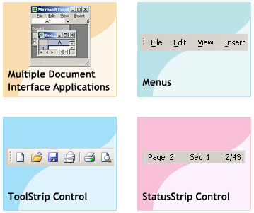
Objectives 2
Multiple Document Interface Applications
Menus
ToolStrip Control
StatusStrip Control

Slide 22
Multiple Document Interface
An application can contain multiple forms, which are used for collecting and displaying varied information
Document Interface
Single Document Interface
Multiple Document Interface

Slide 23
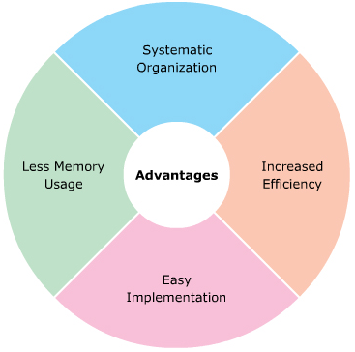
Advantages and Disadvantages
Disadvantage
Difficult Navigation
Risk inconsistent Data
Confusion

Slide 24
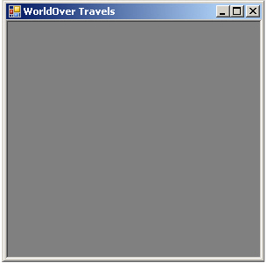
MDI Parent forms
An MDI application consists of a parent form and multiple child forms.
To create parent form:
this.IsMdiContainer =true;

Slide 25
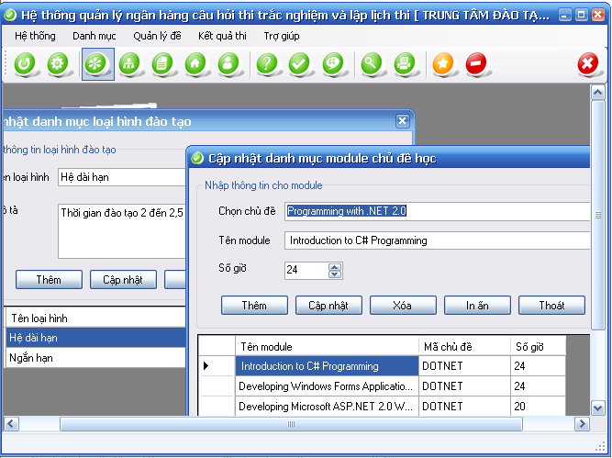
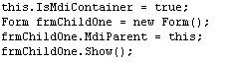
MDI Child Forms
The MDI child forms are the sub-form that are opened within the parent form. When the parent form is closed, all the child forms associated with it are also closed.

Slide 26
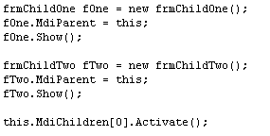
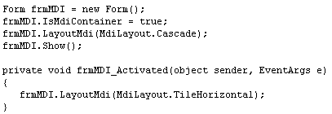
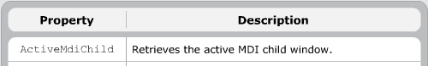
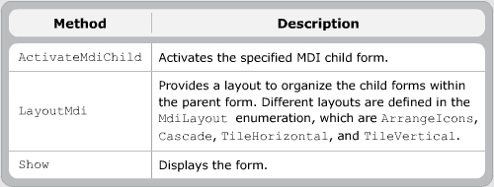
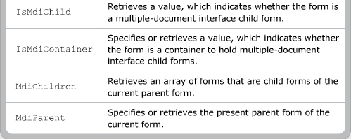
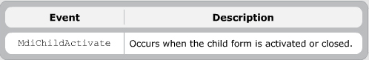
Properties, Methods, and Events

Slide 27
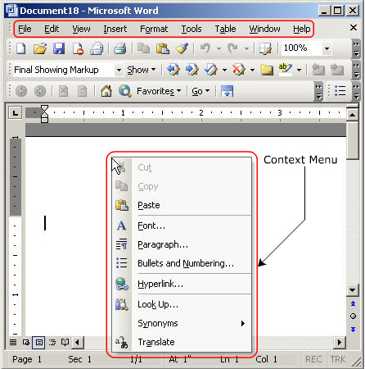
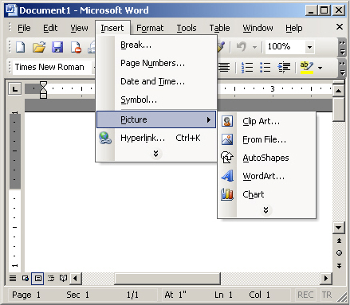
Menu System
The menu system in WF consists of the main panel. The main menu panel consists of menu bars and various sub-menus

Slide 28
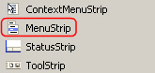
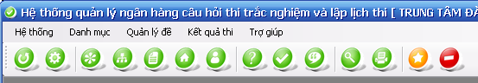
“MenuStrip” Control
The MenuStrip control is a new control introduced in Visual Studio 2005 and .NET Framework 2.0. It allows you to add new menus, modify and reorder existing menus, and delete old menus.

Slide 29
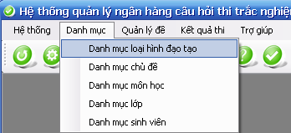
“ToolStripMenuItem” Control
The ToolStripMenuItem class provides various properties, which enable you to modify the appearance and functionality of a menu item.
ToolStripMenuItem

Slide 30
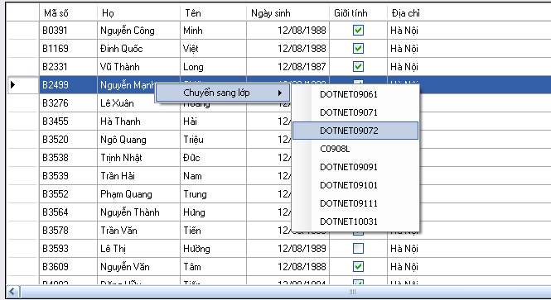
“ContextMenuStrip” Control
The ContextMenuStrip control is used to provide a short cut for accessing menu options displayed on the menu bar. It appears when you right – click on the Control which it associated

Slide 31
“Menu” class
The Menu class allows you to create menus. This class is the base class for MainMenu, MenuItem, and ContextMenu classes.

Slide 32
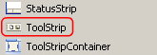
“ToolStrip” Control
The ToolStrip control serves the purpose of the toolbar. It acts as a container to host menu items and other user-defined control

Slide 33
StatusStrip
The StatusStrip control used to display useful information about the task being carried out or various controls in use. It is displayed at the bottom of the form. It can be used to display a progress bar too.

Slide 34
Summary and Workshop
Dialog box
Types of Dialog Boxes
System Defined Dialog Boxes
User Defined Dialog Boxes
Retrieving Information from a Dialog Box
MDI Application and Menus
Multiple Document Interface Applications
Menus
ToolStrip Control
StatusStrip Control

Slide 35

THANKS FOR WATCHING !

